Slide 1
Flutter Advanced Widgets
Notes:
Revise the Task and tell them what’s better to do this task

Slide 2
Agenda
01
02
03
04
Circle Avatar
Media Query
Single Child Scroll View
Inkwell
05
Form
06
Navigation
07
List view
08
Bottom Navigator Bar
09
Stack

Slide 3
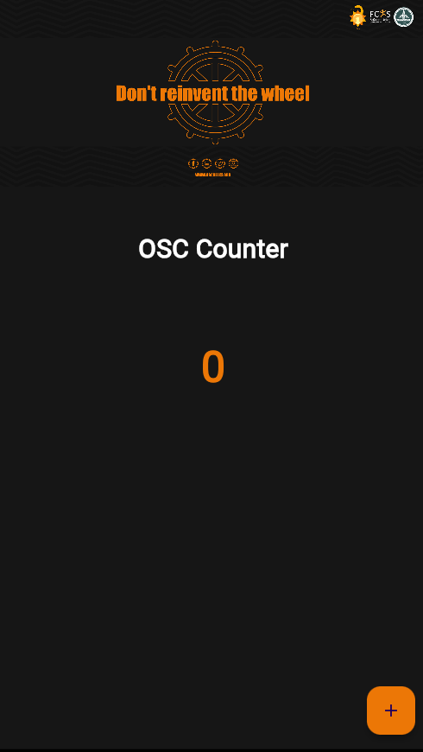
Notes:
First talk about YAML parts of pubspec.yaml YAML (data serialization format)
- It is not a programming language like C++.
- It is not Markup language like HTML.
- YAML is designed to be easily readable and writable by humans.
- It's used for representing configuration settings.
Unlike programming languages such as C++ or Python, YAML doesn't contain functions, conditionals, or loops.

Slide 4
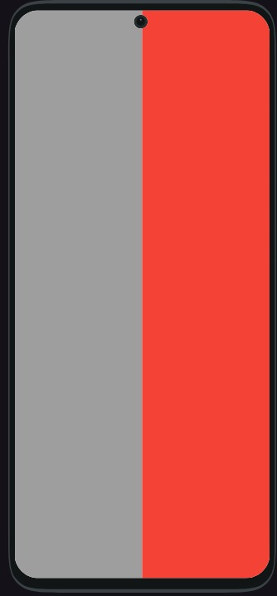
Your Turn

Slide 5
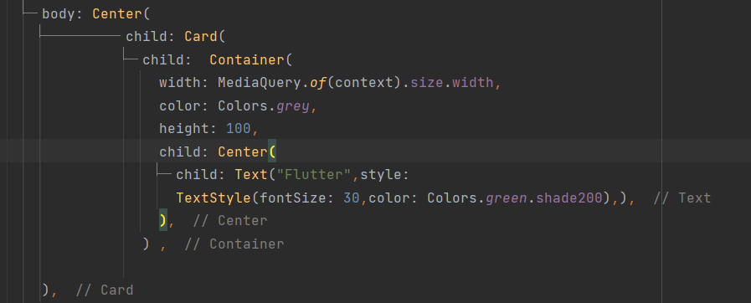
Media Query
It allows us to access the BuildContext context to fetch the device's width, screen height, and other properties.

Slide 6
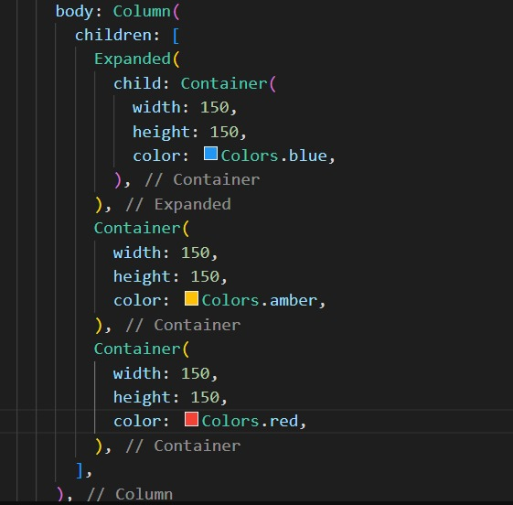
Expanded
Using an Expanded widget makes a child of a Row, Column, or Flex expand to fill the available space along the main axis (e.g., horizontally for a Row or vertically for a Column).

Slide 7
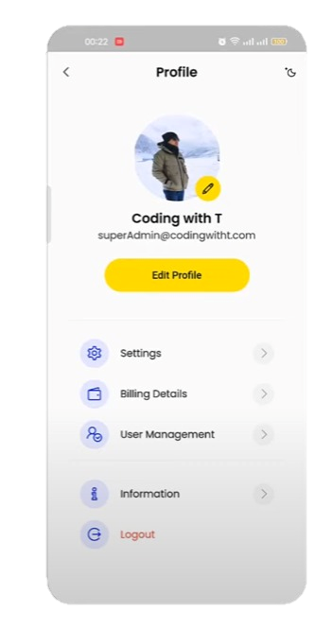
Let’s code

Slide 8
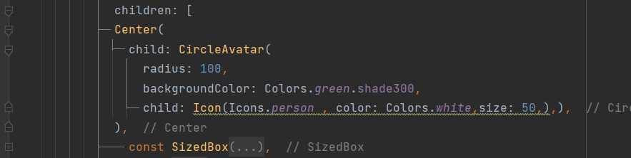
Circle Avatar
used with a user's profile image, or, in the absence of such an image, the user's initials. A given user's initials should always be paired with the same background color, for consistency.

Slide 9
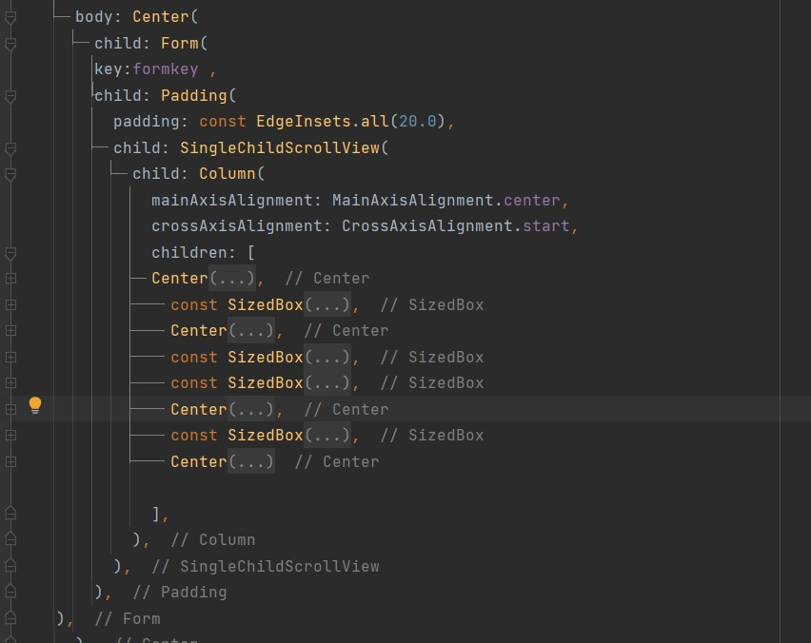
Single Child Scroll View
This widget is useful when you have a single box that will normally be entirely visible, for example a clock face in a time picker, but you need to make sure it can be scrolled if the container gets too small in one axis (the scroll direction).

Slide 10
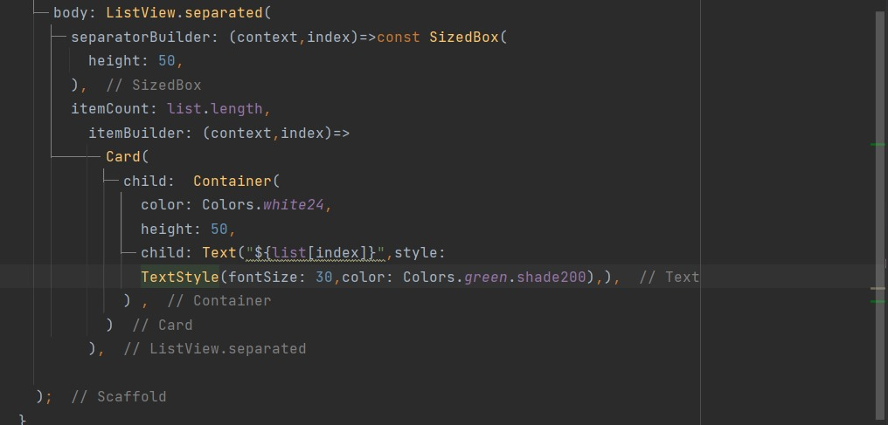
List View
A scrollable list of widgets arranged linearly.

Slide 11
Stack
A widget that positions its children relative to the edges of its box.
This class is useful if you want to overlap several children in a simple way, for example having some text and an image, overlaid with a gradient and a button attached to the bottom.

Slide 12
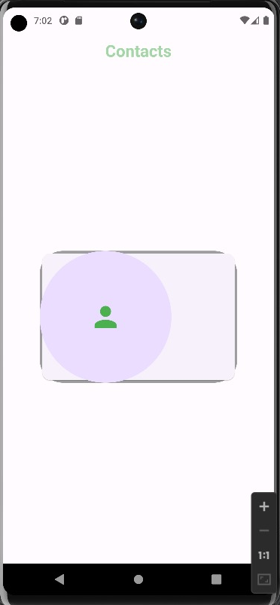
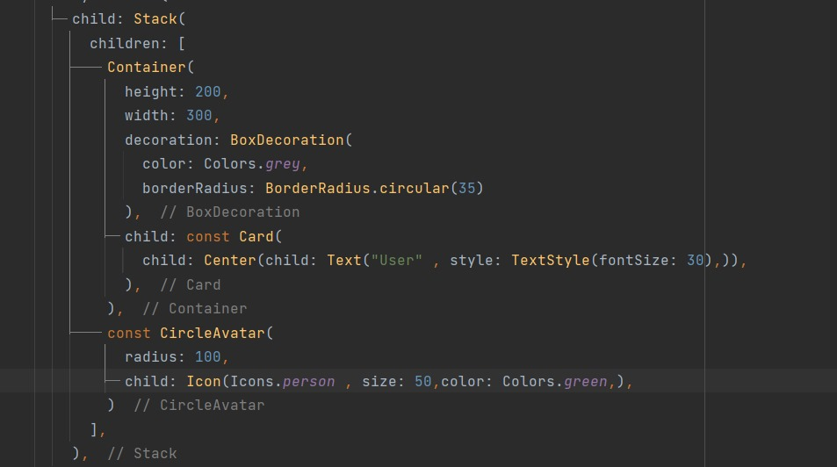
Stack

Slide 13
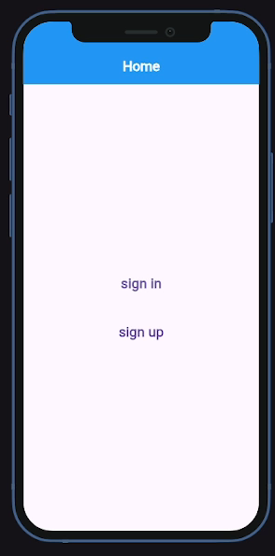

Slide 14
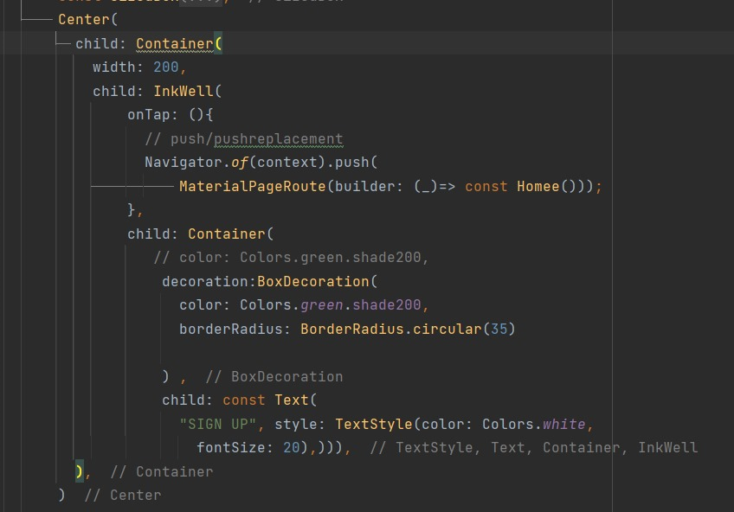
Navigator
the process of switching between different screens or pages within an application

Slide 15
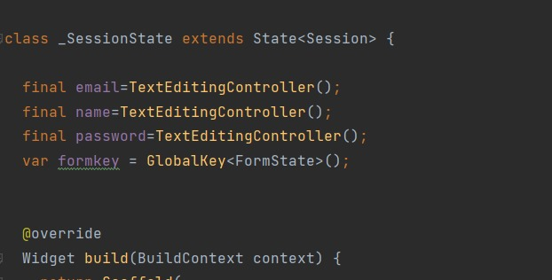
Form
The widget acts as a container for grouping and validating multiple form fields.
When creating the form, provide a GlobalKey. This uniquely identifies the Form, and allows validation of the form in a later step

Slide 16
Form
The widget acts as a container for grouping and validating multiple form fields.
When creating the form, provide a GlobalKey. This uniquely identifies the Form, and allows validation of the form in a later step

Slide 17
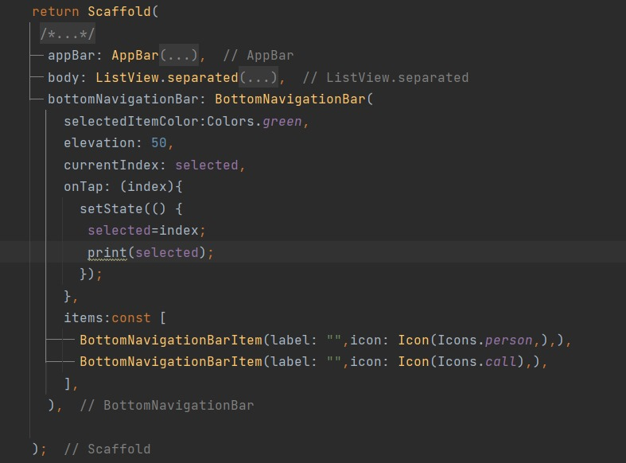
Bottom Navigation Bar
A material widget that's displayed at the bottom of an app for selecting among a small number of views.
The length of items must be at least two and each item's icon and label must not be null.

Slide 18

Inkwell
It responds to the touch action as performed by the user.
Inkwell will respond when the user clicks the button.

Slide 19
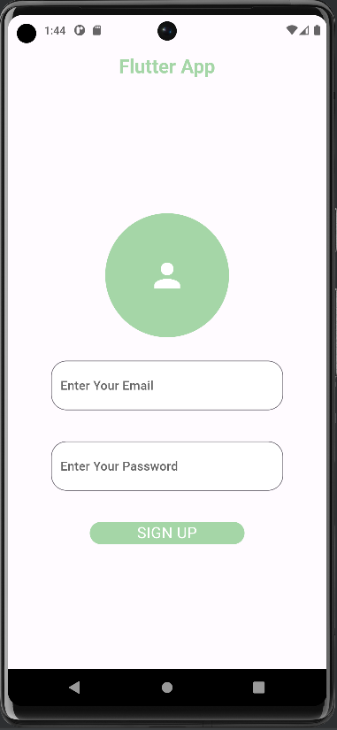
Your Turn!

Slide 20
Thanks !
If you have any problem , send to me 😊

